Slide 1
Ancient Mesopotamia and Mediterranean Societies
Early Mesopotamia
Later Mesopotamia
Hebrews

Slide 2
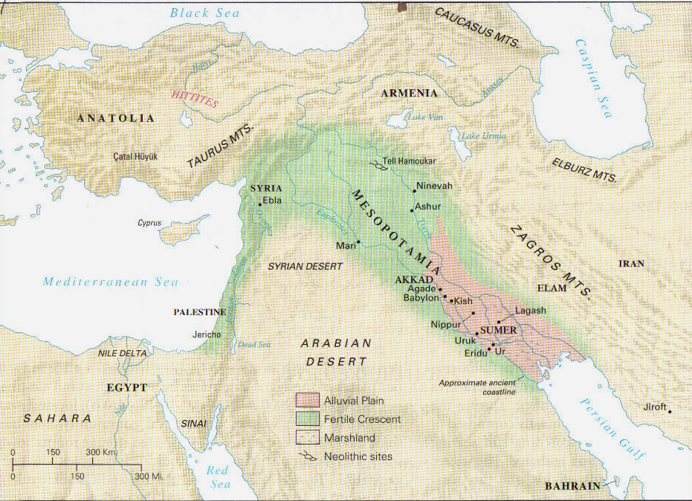

Slide 3
Early Mesopotamia
Sumer (5500 B.C.E.-2340 B.C.E.)
  Political System
  City of Ur
    Ziggurat
  Inventions
  Epic of Gilgamesh

Slide 4
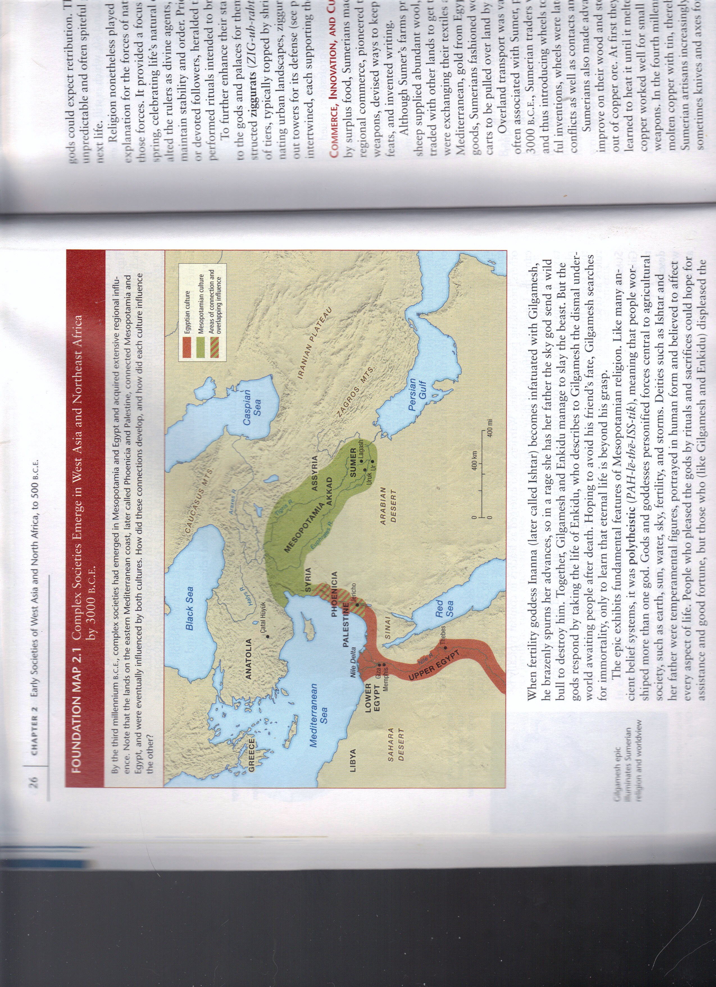

Slide 5
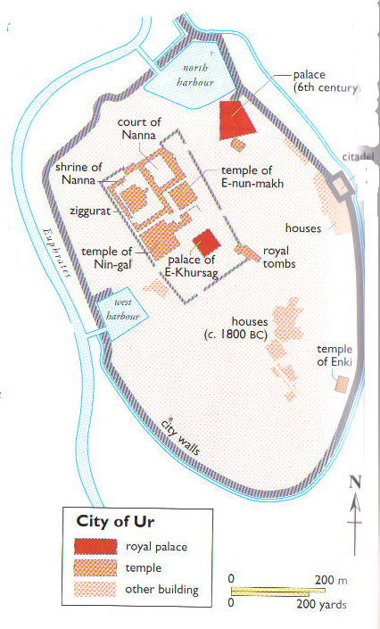
City of Ur

Slide 6
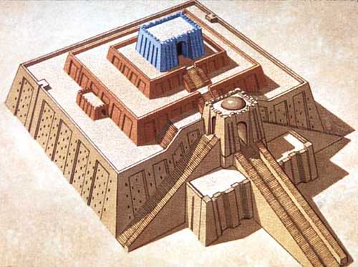
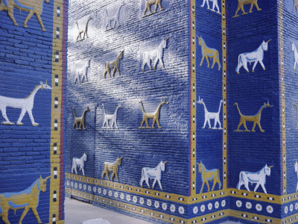
Temple of Ishtar

Slide 7
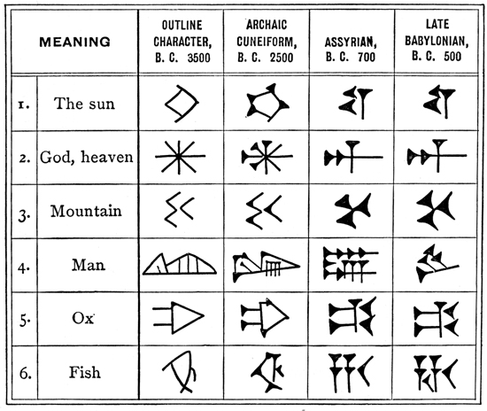

Slide 8
Later Mesopotamia and the Phoenicians
Babylon (c. 1800)
  Political Organization
  Hammurabi (1792 to 1750 B.C.E.)
Assyrians (1350-607 B.C.E)
  “Pony Express”
  Fall of Assyrians by Chaldeans or neo-Babylonians
Phoenicians (1600-300 B.C.E)
  Tyre, Sidon, and Byblos

Slide 9
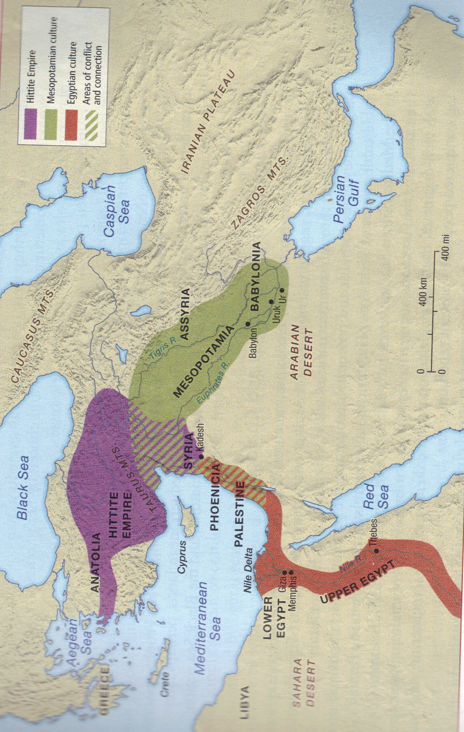

Slide 10
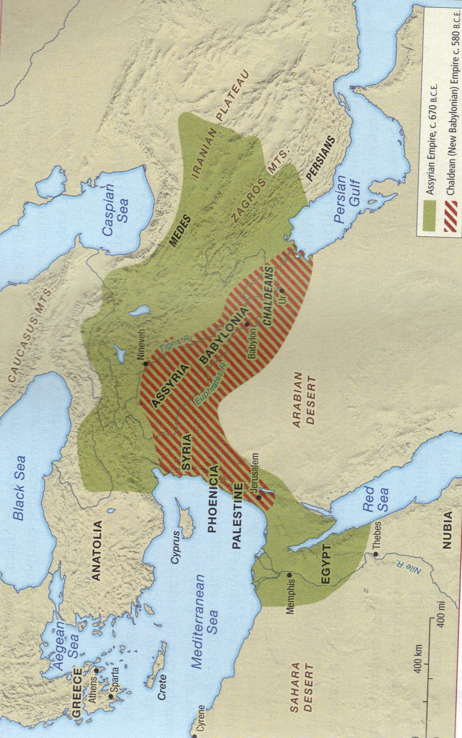

Slide 11
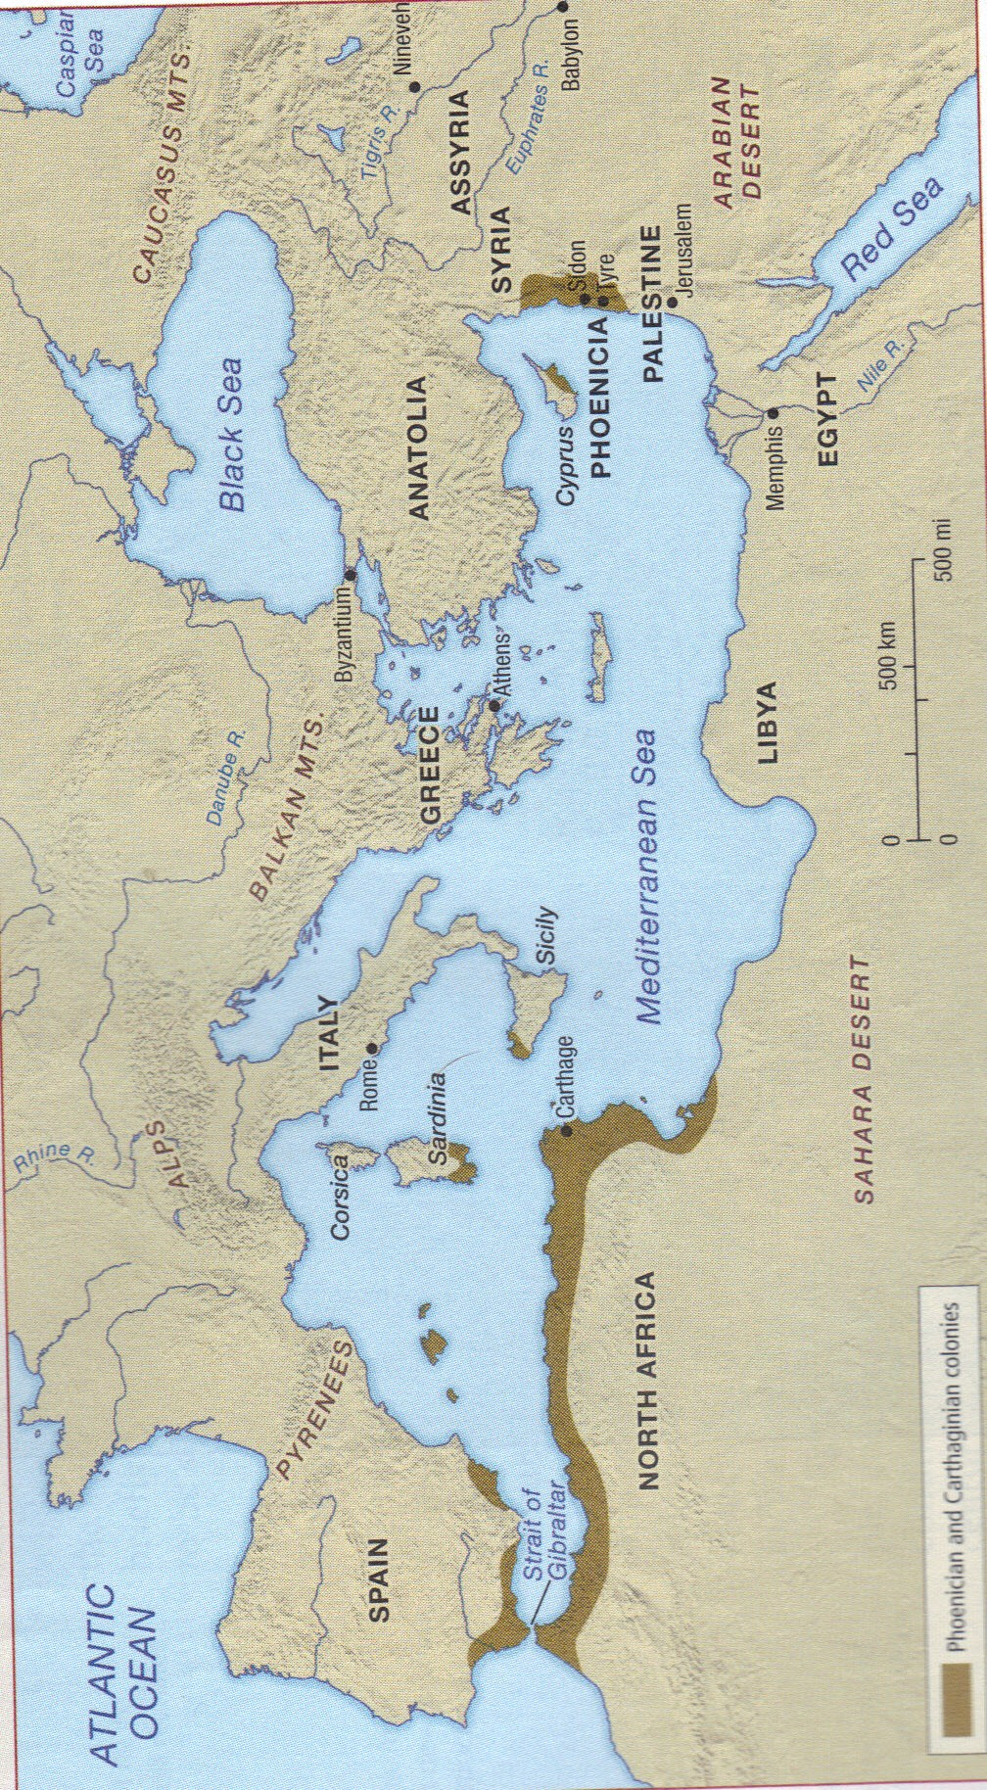

Slide 12
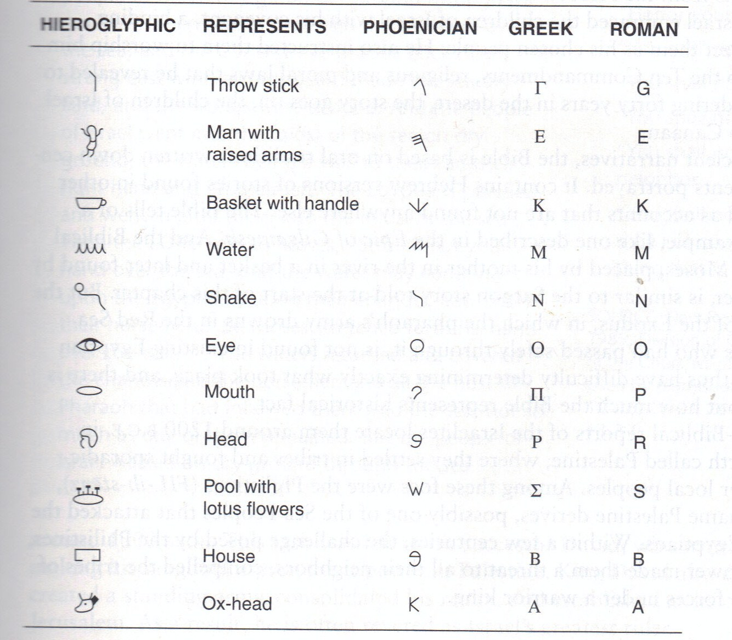

Slide 13
Hebrews, Israelites, and Jews
Abraham
  Ur to Canaan, 1800 B.C.E.
Four Beliefs adopted by other religions
    Monotheism
      Yahweh
    Morality
    Messianism
    Linear History
Tanakh, or Mikra (meaning that “which is read”)
  Torah (Teachings)
  Nevi‘im (Prophets)
  Ketuvim (Writings)
    Hence TaNaKh, an acronym

Slide 14
